Slide 1
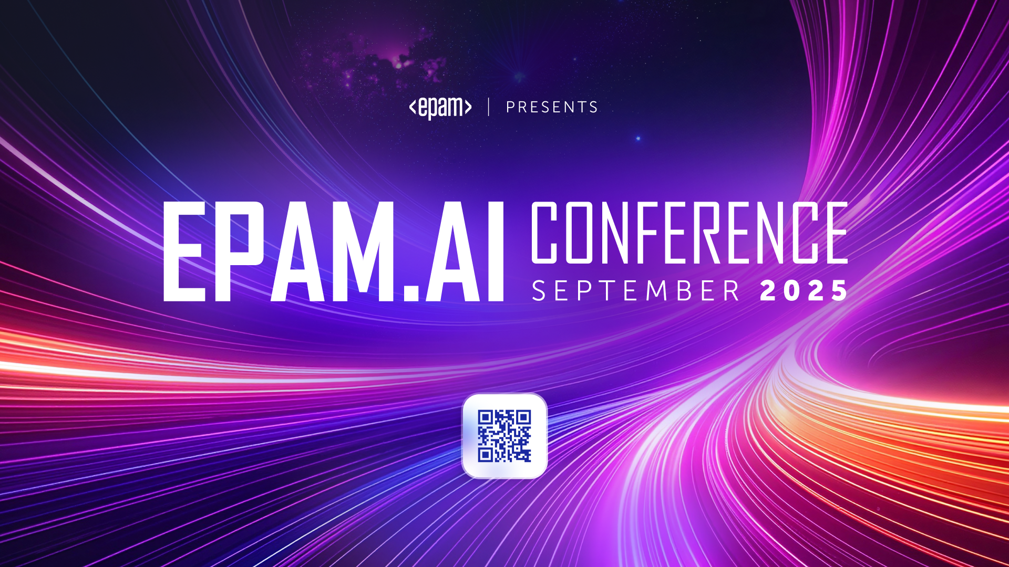
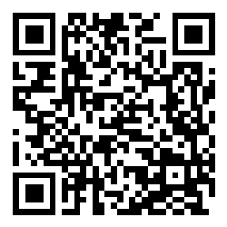

Slide 2
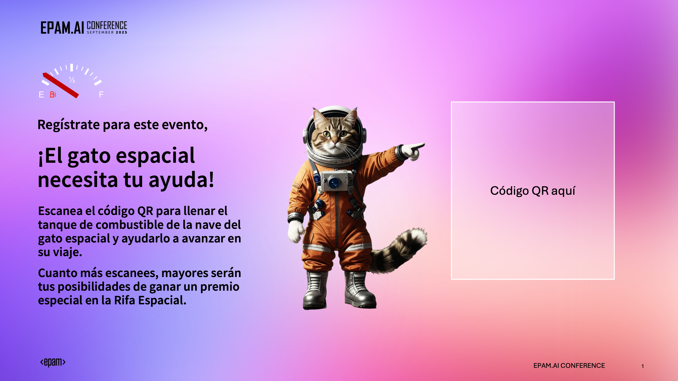

Slide 3
Live QA Engineering Session with GitHub Copilot
Matias Muñoz
EPAM NEORIS

Slide 4
Introduction
Demo
Requeriments Tools Setup
Prepare and Run Use Case
Aplication Fields
Q&A

Slide 5
01 –Introduction
Approaching daily tasks with the assistance of GitHub Copilot
“From testing to everyday life”

Slide 6
Introduction
Daily Tasks of a Tester
GitHub Copilot Features
From Task to Solution
Early defect detection and incident prevention
Reading functional documentation and defining acceptance criteria
Test plan creation and building test strategy
Creation and writing of test cases
Use and update of management tools
Test automation, code generation, and continuous integration
Metrics analysis, reporting, and performance testing
Github Copilot – Web
Github Copilot – Models/Marketplace
Github Copilot – Inline / Autocomplete
Github Copilot – Chat
Github Copilot – Edits /Agents
Github Copilot – Vision
Github Copilot – Custom Instructions
Github Copilot – Prompt Files.
Github Copilot – Instructions
GitHub Copilot – MCP Server
Select a daily task and describe its main steps.
Identify which Copilot features can support each step.
Plan how to combine these features to automate, simplify, or improve the task.
Build and test the solution, adjusting as needed for optimal results.

Slide 7
02 – Demo
Performing a live QA Tasks demonstration
“Making Copilot your personal assistant”

Slide 8
Demo
Operational tasks (non-technical)
Technical tasks
Daily routines beyond QA
Analysis of functional documentation
JIRA administration
Creation of test cases
Analysis and creation of user stories
Organizing meeting notes
Tracking project deadlines
Test case automation
Creation and execution of pipelines
CI/CD tasks
Integrating automated test results into dashboards
Scripting data validation processes
Comparing product price availability
Building shopping carts
Scheduling reminders for daily activities
Automating email responses

Slide 9
03 – Tool Setup Requirements
Preparing all essential tools required for your QA workflow.
"Choose your superpower"

Slide 10
Tool Setup Requirements
Essential Core Tools
Workflow-Specific Integrations
Copilot Setup and Guidance
Install fundamental development tools (Python, Node.js, Visual Studio Code)
Add basic extensions (Git, linters, code formatters)
Configure environment variables and basic settings
Set up integrations based on your workflow (JIRA MCP Server, Playwright MCP Server)
Install documentation and conversion tools (Markdown, Word/PDF converters)
Connect databases, CI/CD systems, and other workflow-specific platforms
Enable Copilot Agent Mode for advanced automation
Create and manage Prompt Files and Instruction Files
Define Copilot Instructions and Models for process guidance
Use Chat Mode for interactive assistance and troubleshooting

Slide 11
04 – Prepare and Run Use Case
Set up and run a real-world example with chosen tools and Copilot.
"I want it my way"

Slide 12
Prepare and Run Use Case
Prompt File Best Practices
Instruction File Guidelines
General Copilot Setup Tips
Clearly define the step-by-step workflow for the task.
Use concise and actionable instructions.
Organize prompts logically to guide Copilot effectively.
Include context or examples when necessary.
Provide detailed information for complex processes.
Break down instructions into manageable sections.
Reference related files or resources for clarity.
Update instructions regularly to reflect changes in workflow.
Ensure all required tools and extensions are installed.
Test your workflow with sample tasks before full implementation.
Use version control for prompt and instruction files.
Document the setup process for team collaboration.

Slide 13
05 – Application Fields

Slide 14
Application Fields
Administrative & Management Tasks
Core QA Operations
Personal Productivity & Life Management
• Documentation Generation: Technical manuals, bug reports, test plans, quality metrics dashboards
• Tool Administration: Jira/TestRail setup, environment configuration, repository maintenance, CI/CD pipeline management • Functional Analysis: Requirements review, acceptance criteria definition, impact analysis, risk assessment
• Test Design & Writing: Test case generation from requirements, BDD/Gherkin scenarios, test data creation, coverage matrices
• Execution & Exploration: Exploratory testing sessions, API testing with Postman, performance testing, security validation
• Test Automation: Selenium/Playwright/Robot Framework scripts, mobile automation with Appium, CI/CD integration, suite maintenance
• Financial Management: Shopping cart analysis, price comparison, budget planning, investment tracking, deal optimization
• Professional Development: Technology research, personal projects, certification planning, skill development, code optimization
• Daily Life Organization: Travel planning, household management, health & fitness tracking, event coordination

Slide 15
06 – Q&A

